Slide 2
Advanced Deep Learning: How to Overcome Real World Data Problems Using GANs
Anusua Trivedi
Data Scientist, AI+R
email: antriv@microsoft.com
twitter: @anurive

Slide 3
Resources: https://aka.ms/gan

Slide 4
Outline
Part 1: Introduction to GANs
Part 2: Some challenges with GANs
Part 3: Applications of GANs

Slide 5
Generative Adversarial Networks ( GAN )
The coolest idea in ML in the last twenty years - Yann Lecun

Slide 6
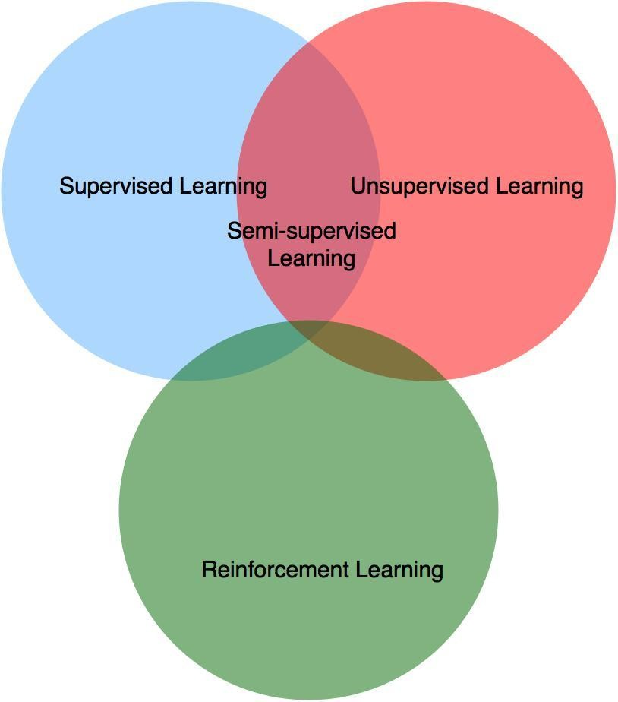
Taxonomy of ML

Slide 7
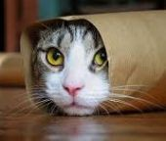
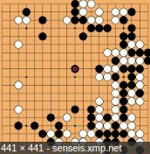
Supervised Learning
Find deterministic function f :
y = f(x),
x : data, y : label
f
f
Cat
F18

Slide 8
Supervised Learning
Challenges
Image is high dimensional data
224 x 224 x 3 = 150,528
Many variations
viewpoint, illumination, deformation, occlusion, background clutter, intraclass variation

Slide 9
Supervised Learning
Solution
Feature Vector
150,528 → 2,048
Synonyms
Latent Vector, Hidden Vector, Unobservable Vector, Feature, Representation

Slide 10
Supervised Learning
More flexible solution
– Get probability of the label for given data instead of label itself
f
Cat : 0.98
Cake : 0.02
Dog : 0.00

Slide 11
Unsupervised Learning
Find deterministic function f :
z = f(x),
x : data, z : latent
f
[0.1, 0.3, -0.8, 0.4, … ]

Slide 12
Unsupervised Learning
More challenging than supervised learning :
– No label or curriculum → self learning
Some NN solutions :
Boltzmann machine
Auto-encoder or Variational Inference
Generative Adversarial Network

Slide 13
Generative Model
Find generation function g :
x = g(z),
x : data, z : latent
g
[0.1, 0.3, -0.8, 0.4, … ]

Slide 14
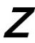
Unsupervised learning vs. Generative model
z = f(x) vs. x = g(z)
P(z|x) vs. P(x|z)
Encoder vs. Generator
P(x, z) needed. ( cf : P(y|x) in supervised learning )
P(z|x) = P(x, z) / P(x) → P(x) is intractable ( ELBO )
P(x|z) = P(x, z) / P(z) → P(z) is given. ( prior )

Slide 15
Part 1
Motivation for Generative Models
From Adversarial Training to GANs
GAN’s Architecture
GAN’s objective
DCGANs

Slide 16
GANs
Generative
Learn a generative model
Adversarial
Trained in an adversarial setting
Networks
Use Deep Neural Networks

Slide 17
Why Generative Models?
We’ve only seen discriminative models so far
Given an image X, predict a label Y
Estimates P(Y|X)
Discriminative models have several key limitations
Can’t model P(X), i.e. the probability of seeing a certain image
Thus, can’t sample from P(X), i.e. can’t generate new images
Generative models (in general) cope with all of above
Can model P(X)
Can generate new images

Slide 18
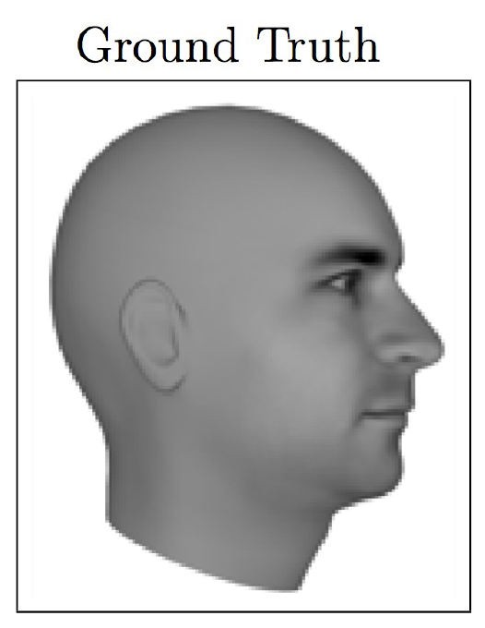
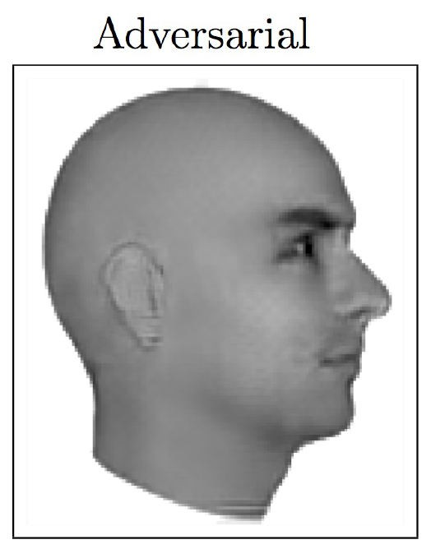
Magic of GANs…
Lotter, William, Gabriel Kreiman, and David Cox. "Unsupervised learning of visual structure using predictive generative networks." arXiv preprint arXiv:1511.06380 (2015).

Slide 19
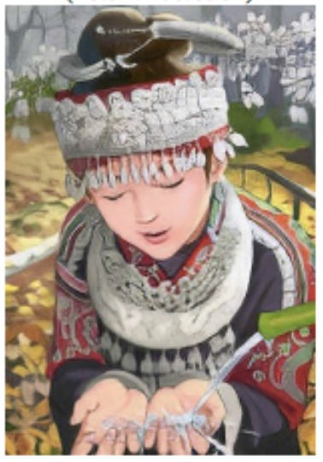
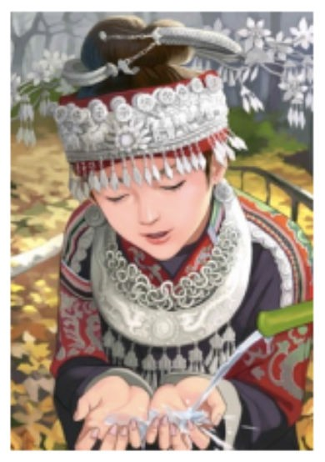
Magic of GANs…
Which one is Computer generated?
Ledig, Christian, et al. "Photo-realistic single image super-resolution using a generative adversarial network." arXiv preprint arXiv:1609.04802 (2016).

Slide 20
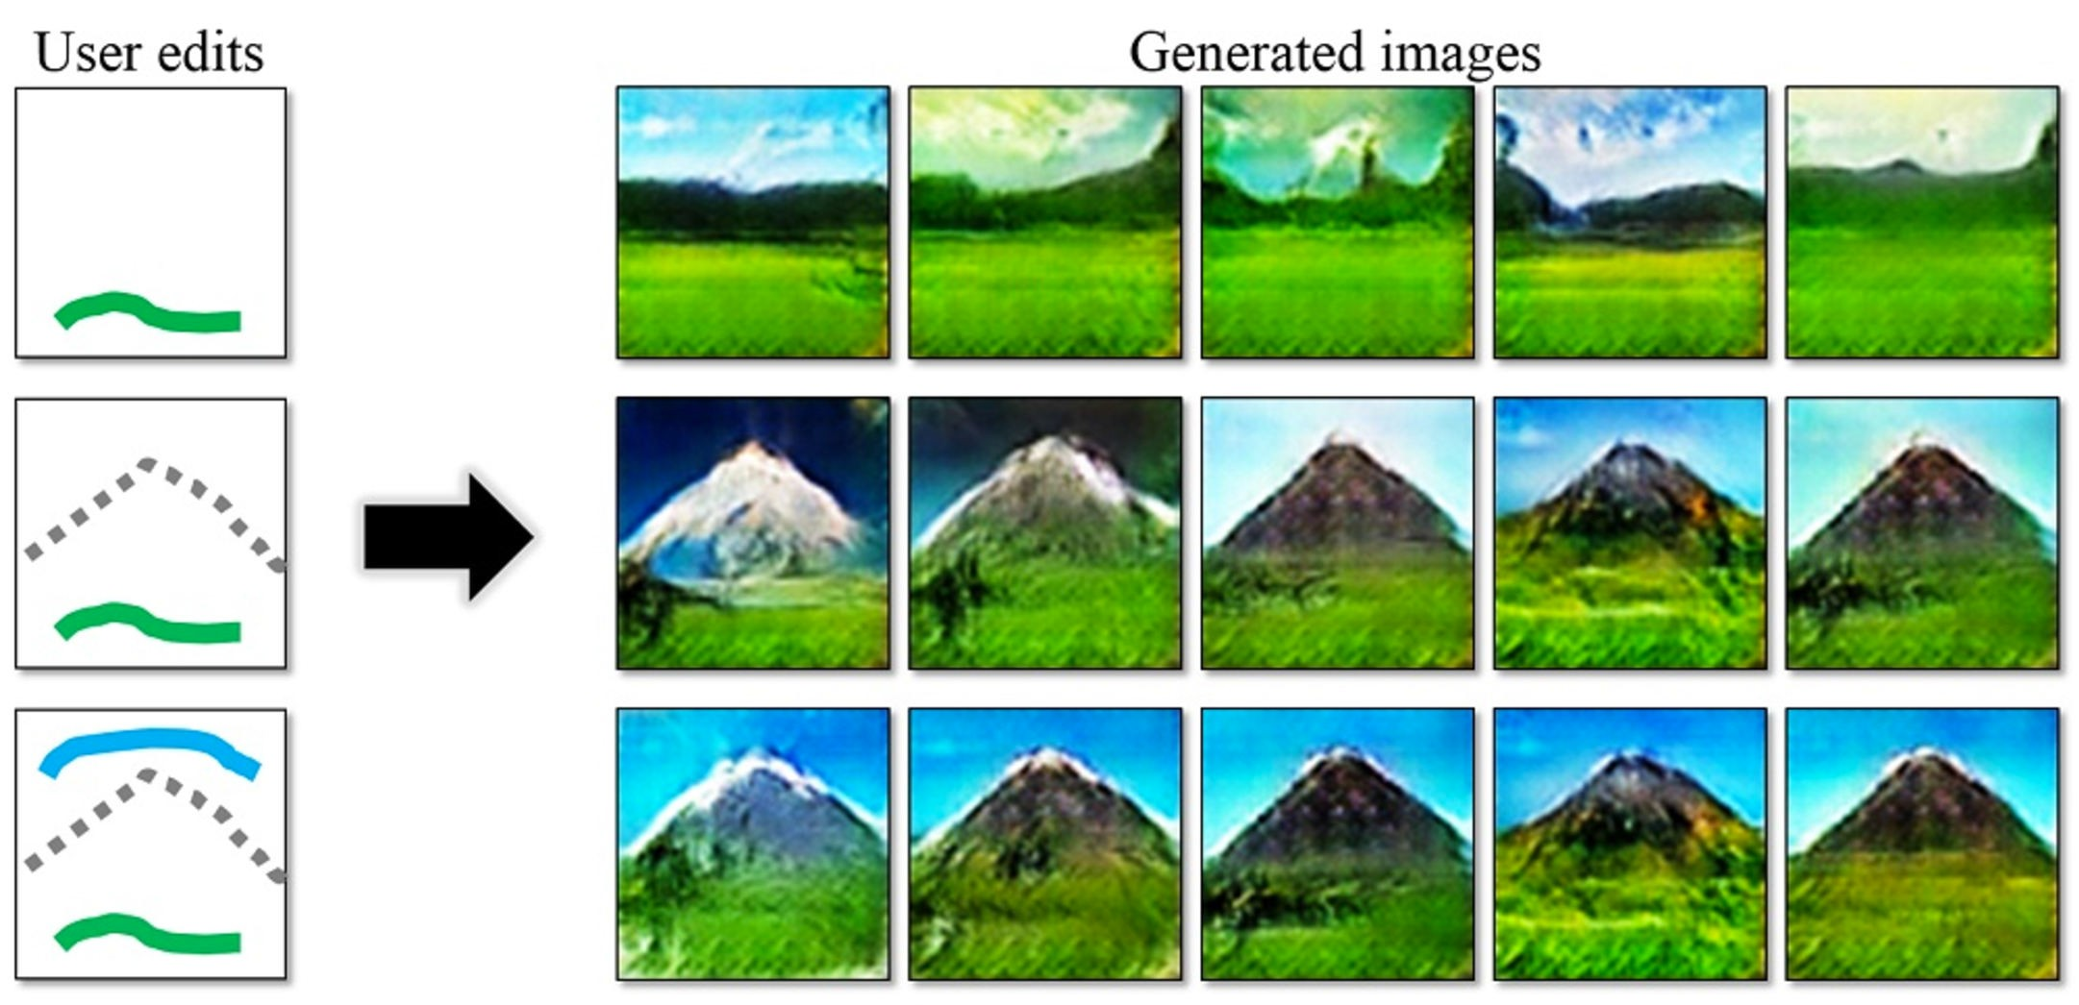
Magic of GANs…
http://people.eecs.berkeley.edu/~junyanz/projects/gvm/

Slide 21
Adversarial Training
For Generative models:
We can generate adversarial samples to fool a discriminative model
We can use those adversarial samples to make models robust
We then require more effort to generate adversarial samples
Repeat this and we get better discriminative model
GANs extend that idea to generative models:
Generator: generate fake samples, tries to fool the Discriminator
Discriminator: tries to distinguish between real and fake samples
Train them against each other
Repeat this and we get better Generator and Discriminator

Slide 22
Autoencoders

Slide 23
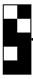
Stacked autoencoder - SAE
Use data itself as label
f
(enc)
z
g
(dec)
x
’
x
Supervised learning with L2 loss ( = MSE )

Slide 24
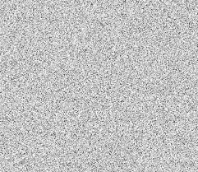
Denoising autoencoder - DAE
Almost same as SAE
Add random noise to input data
f
(enc)
z
g
(dec)
x
’
x + noise
Supervised learning with L2 loss ( = MSE )

Slide 25
Variational autoencoder - VAE
Generative Model + Stacked Autoencoder
Based on Variational approximation
other approaches :
Point estimation ( MAP )
Markov Chain Monte Carlo ( MCMC )

Slide 26
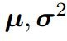
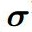
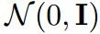
Variational autoencoder - VAE
f
(enc)
z
g
(dec)
+
x
’
x
z :
Supervised learning with L2 loss ( = MSE ) + KL regularizer

Slide 27
Generative Adversarial Networks

Slide 28
Generative Adversarial Networks - GAN
GAN
Ian Goodfellow et al, “Generative Adversarial Networks”, 2014.
Learnable cost function
Mini-Max game based on Nash Equilibrium
Little assumption
High fidelity
Hard to training - no guarantee to equilibrium.

Slide 29
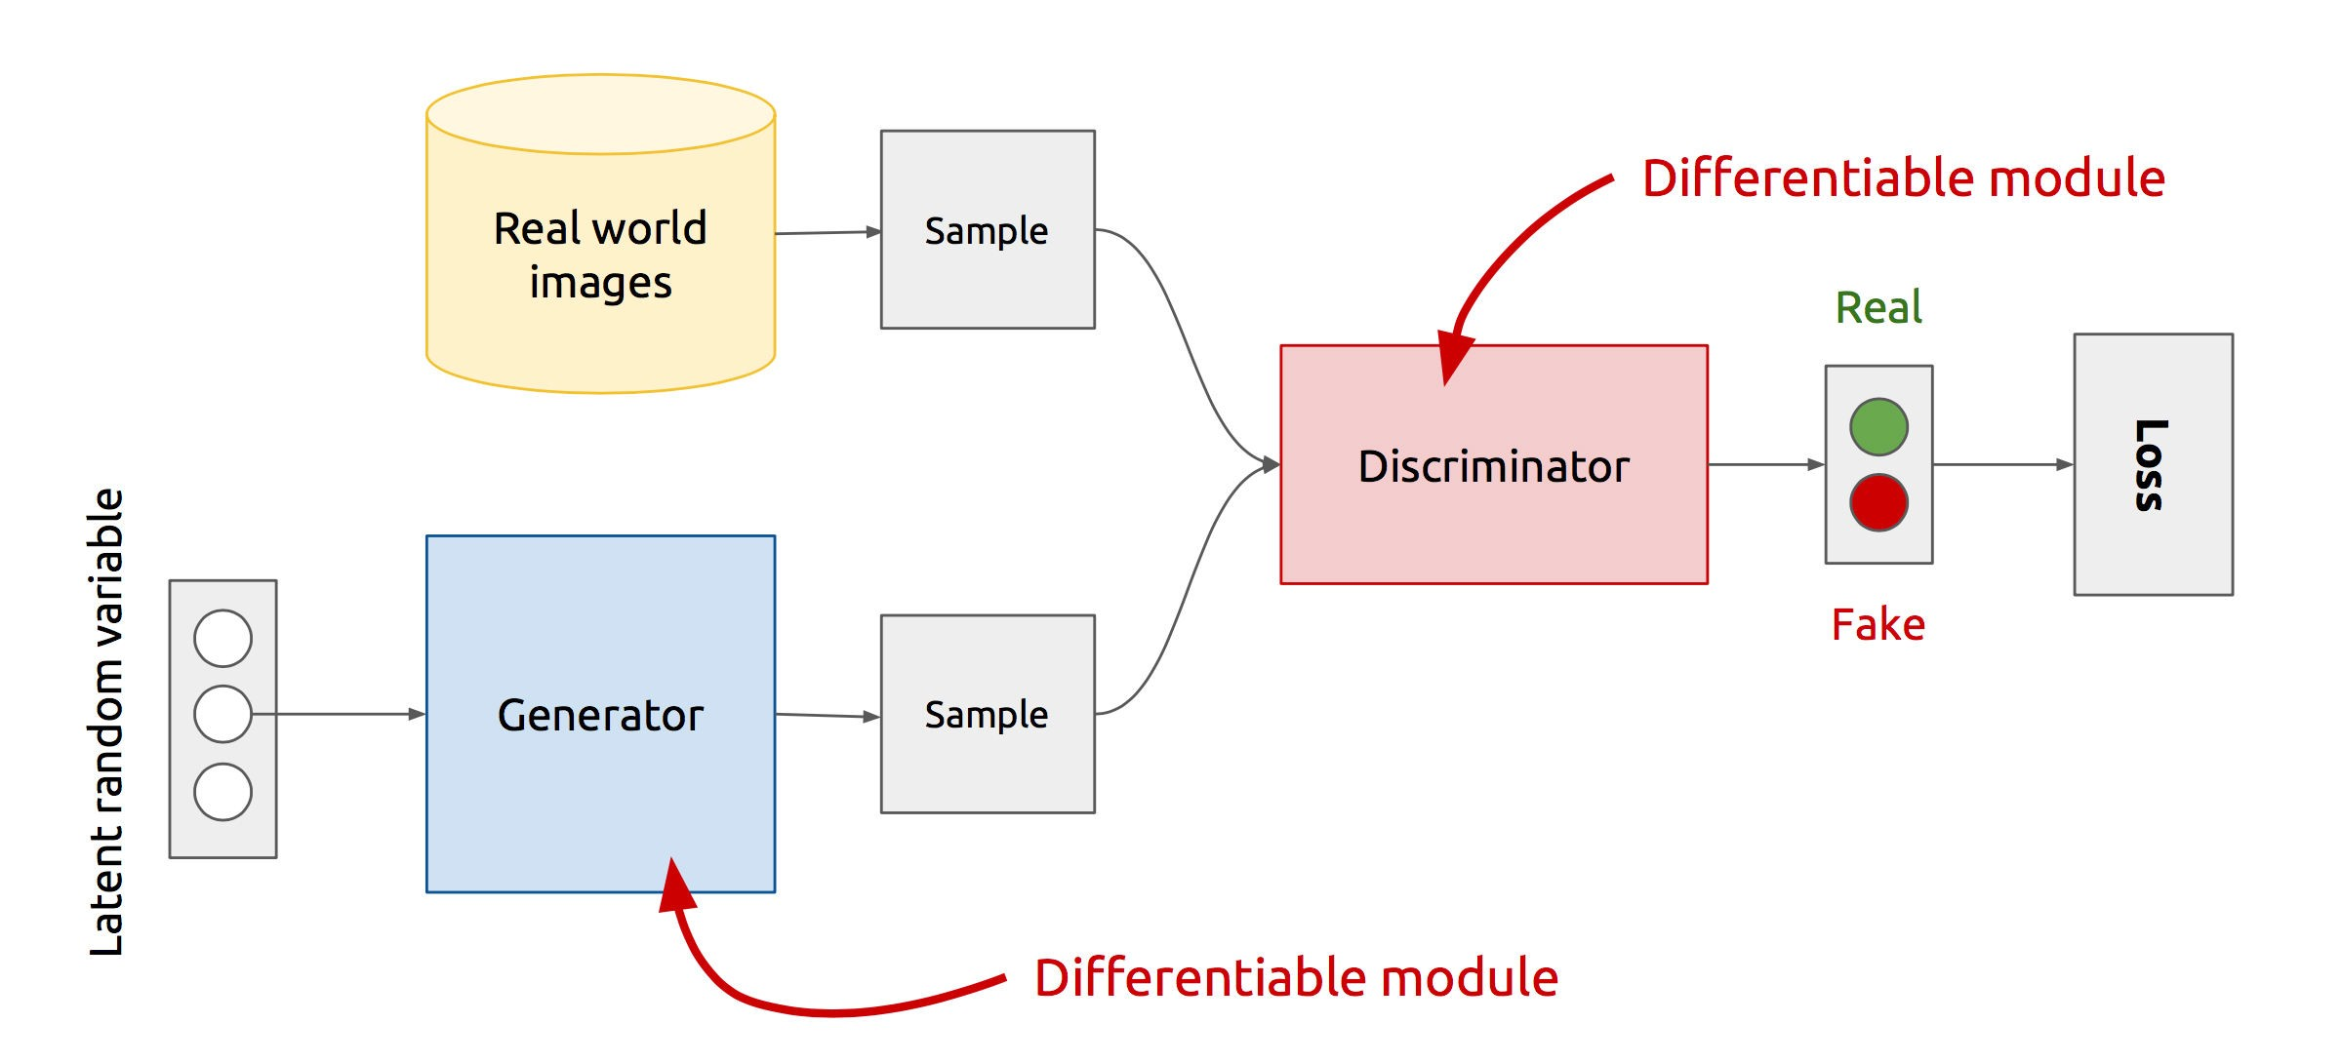
GAN’s Architecture
x
D
D(x)
G
z
G(z)
D(G(z))
Z is some random noise (Gaussian/Uniform).
Z can be thought as the latent representation of the image.
https://www.slideshare.net/xavigiro/deep-learning-for-computer-vision-generative-models-and-adversarial-training-upc-2016

Slide 30
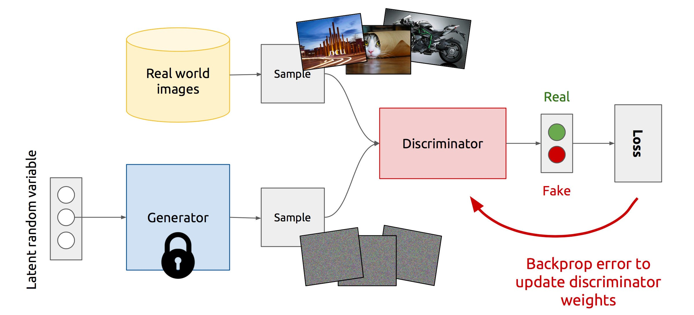
Training Discriminator
https://www.slideshare.net/xavigiro/deep-learning-for-computer-vision-generative-models-and-adversarial-training-upc-2016

Slide 31
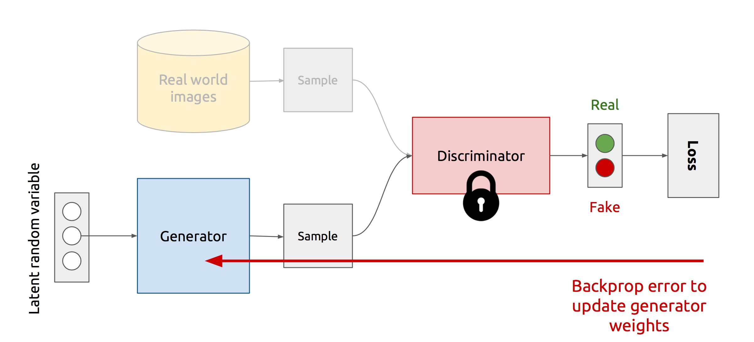
Training Generator
https://www.slideshare.net/xavigiro/deep-learning-for-computer-vision-generative-models-and-adversarial-training-upc-2016

Slide 32
GAN’s formulation
min max 𝑉 𝐷, 𝐺
'
It is formulated as a minimax game, where:
The Discriminator is trying to maximize its reward 𝑽 𝑫, 𝑮 (or minimize its loss)
The Generator is trying to minimize Discriminator’s reward (or maximize its loss)
𝑉 𝐷, 𝐺
= 𝔼_{1∼3(1)} log 𝐷 𝑥 + 𝔼_{;∼<(;)} log 1 − 𝐷 𝐺(𝑧)
The Nash equilibrium of this particular game is achieved when the model converges

Slide 33
Vanishing gradient strikes back again…
min max 𝑉 𝐷, 𝐺
𝑉 𝐷, 𝐺
^{= 𝔼}1∼3(1)
log𝐷 𝑥 +
^{𝔼};∼<(;)
log 1 − 𝐷 𝐺(𝑧)
Gradient goes to 0 if 𝐷 is confident, i.e. 𝐷 𝐺 𝑧 → 0
Minimize −𝔼;~< ;
log 𝐷 𝐺 𝑧
for Generator instead (keep Discriminator as it is)

Slide 34
Part 2
Advantages/Disadvantages of GANs
Training Challenges
Non-Convergence
Mode-Collapse
Proposed Solutions
Supervision with Labels
Mini-Batch GANs
Modification of GAN’s losses
Discriminator (EB-GAN)
Generator (InfoGAN)

Slide 35
Advantages of GANs
Plenty of existing work on Deep Generative Models
Boltzmann Machine
Deep Belief Nets
Variational AutoEncoders(VAE)
Why GANs?
Sampling (or generation) is straightforward.
Training doesn't involve Maximum Likelihood estimation.
Robust to Overfitting since Generator never sees the training data.
Empirically GANs are good at capturing the modes of the distribution.
Goodfellow, Ian. "NIPS 2016 Tutorial: Generative Adversarial Networks." arXiv preprint arXiv:1701.00160 (2016).

Slide 36
Pitfall of GAN
No guarantee to equilibrium
– Mode collapsing
Oscillation
No indicator when to finish
All generative model
Evaluation metrics ( Human turing test )
Overfitting test ( Nearest Neighbor ) → GAN is robust !!!
Diversity test

Slide 37
Training Problems
Non-Convergence
Mode-Collapse

Slide 38
Deep Learning models (in general) involve a single player
The player tries to maximize its reward (minimize its loss).
Use SGD (with Backpropagation) to find the optimal parameters.
SGD has convergence guarantees (under certain conditions).
Problem: With non-convexity, we might converge to local optima.
min 𝐿 𝐺
$
GANs instead involve two (or more) players
Discriminator is trying to maximize its reward.
Generator is trying to minimize Discriminator’s reward.
min max 𝑉 𝐷, 𝐺
$ '
SGD was not designed to find the Nash equilibrium of a game.
Problem: We might not converge to the Nash equilibrium at all.
Salimans, Tim, et al. "Improved techniques for training gans." Advances in Neural Information Processing Systems. 2016.

Slide 39
Problems with GANs
Non-Convergence
Mode-Collapse

Slide 40
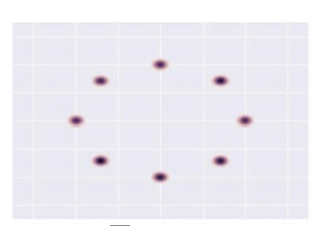
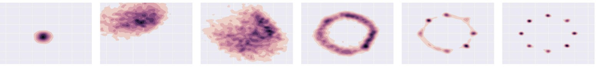
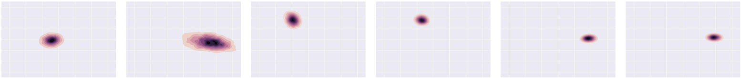
Mode-Collapse
Generator fails to output diverse samples
Target
Expected
Output
Metz, Luke, et al. "Unrolled Generative Adversarial Networks." arXiv preprint arXiv:1611.02163 (2016).

Slide 41
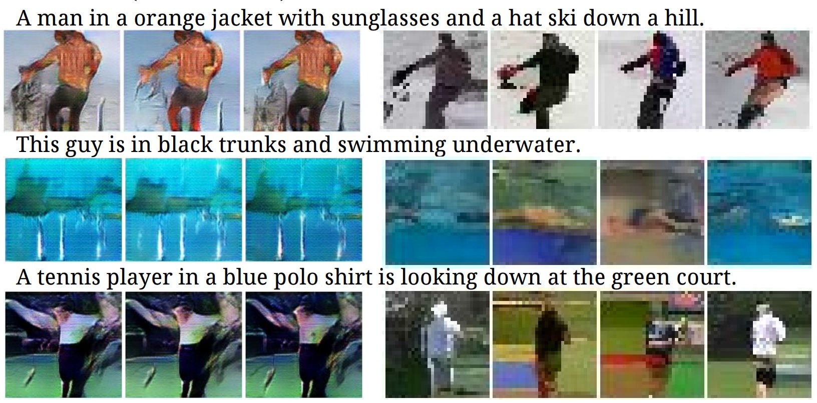
Some real examples
Reed, S., et al. Generating interpretable images with controllable structure. Technical report, 2016. 2, 2016.

Slide 42
Some Solutions
Mini-Batch GANs
Supervision with labels
Some recent attempts :-
Unrolled GANs
W-GANs

Slide 43
Basic (Heuristic) Solutions
Mini-Batch GANs
Supervision with labels

Slide 44
How to reward sample diversity?
At Mode Collapse,
Generator produces good samples, but a very few of them.
Thus, Discriminator can’t tag them as fake.
To address this problem,
Let the Discriminator know about this edge-case.
More formally,
Let the Discriminator look at the entire batch instead of single examples
If there is lack of diversity, it will mark the examples as fake
Thus,
Generator will be forced to produce diverse samples.
Salimans, Tim, et al. "Improved techniques for training gans." Advances in Neural Information Processing Systems. 2016.

Slide 45
Mini-Batch GANs
Extract features that capture diversity in the mini-batch
For e.g. L2 norm of the difference between all pairs from the batch
Feed those features to the discriminator along with the image
Feature values will differ b/w diverse and non-diverse batches
Thus, Discriminator will rely on those features for classification
This in turn,
Will force the Generator to match those feature values with the real data
Will generate diverse batches
Salimans, Tim, et al. "Improved techniques for training gans." Advances in Neural Information Processing Systems. 2016.

Slide 46
Basic (Heuristic) Solutions
Mini-Batch GANs
Supervision with labels

Slide 47
Supervision with Labels
Label information of the real data might help
Car
Dog
Real
D
D
Human
Fake
Fake
Empirically generates much better samples

Slide 48
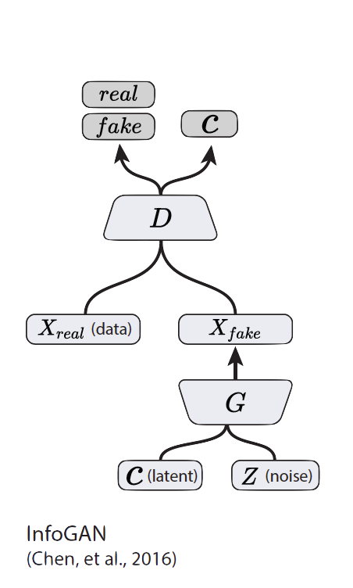
How to reward Disentanglement?
Disentanglement means individual dimensions independently capturing key attributes of the image
Let’s partition the noise vector into 2 parts :-
z vector will capture slight variations in the image
c vector will capture the main attributes of the image
For e.g. Digit, Angle and Thickness of images in MNIST
If c vector captures the key variations in the image,
Will c and 𝒙_{𝒇𝒂𝒌𝒆} be highly correlated or weakly correlated?
Chen, X., Duan, Y., Houthooft, R., Schulman, J., Sutskever, I., & Abbeel, P. InfoGAN: Interpretable Representation Learning by Information Maximization Generative Adversarial Nets

Slide 49
Variants of GANs

Slide 50
DCGAN
Radford et al, Unsupervised Representation Learning with Deep Convolutional Generative Adversarial Networks, 2015
Tricks for gradient flow
Max pooling → Strided convolution or average pooling
Use LeakyReLU instead of ReLU
Other tricks
Use batch normal both generator and discriminator
Use Adam optimizer ( lr = 0.0002, a = 0.9, b=0.5 )

Slide 51
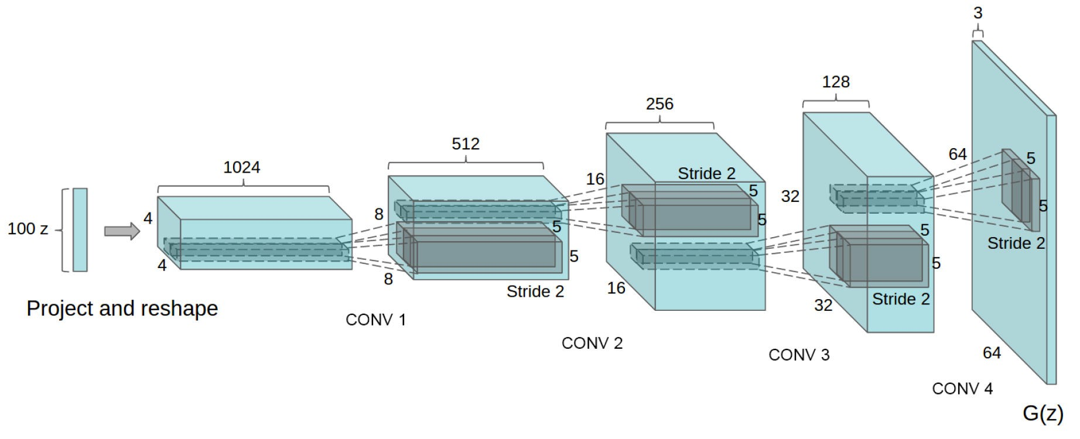
Deep Convolutional GANs (DCGANs)
Key ideas:
Replace FC hidden layers with Convolutions
Generator: Fractional-Strided convolutions
Use Batch Normalization after each layer
Inside Generator
Use ReLU for hidden layers
Use Tanh for the output layer
Generator Architecture
Radford, Alec, Luke Metz, and Soumith Chintala. "Unsupervised representation learning with deep convolutional generative adversarial networks." arXiv:1511.06434 (2015).

Slide 52
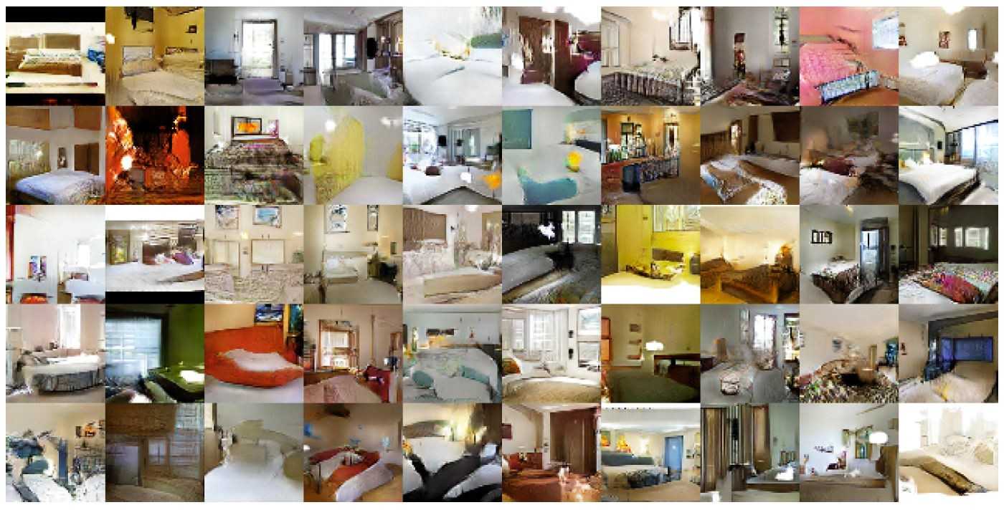
DCGAN: Bedroom images
Radford, Alec, Luke Metz, and Soumith Chintala. "Unsupervised representation learning with deep convolutional generative adversarial networks." arXiv:1511.06434 (2015).

Slide 53
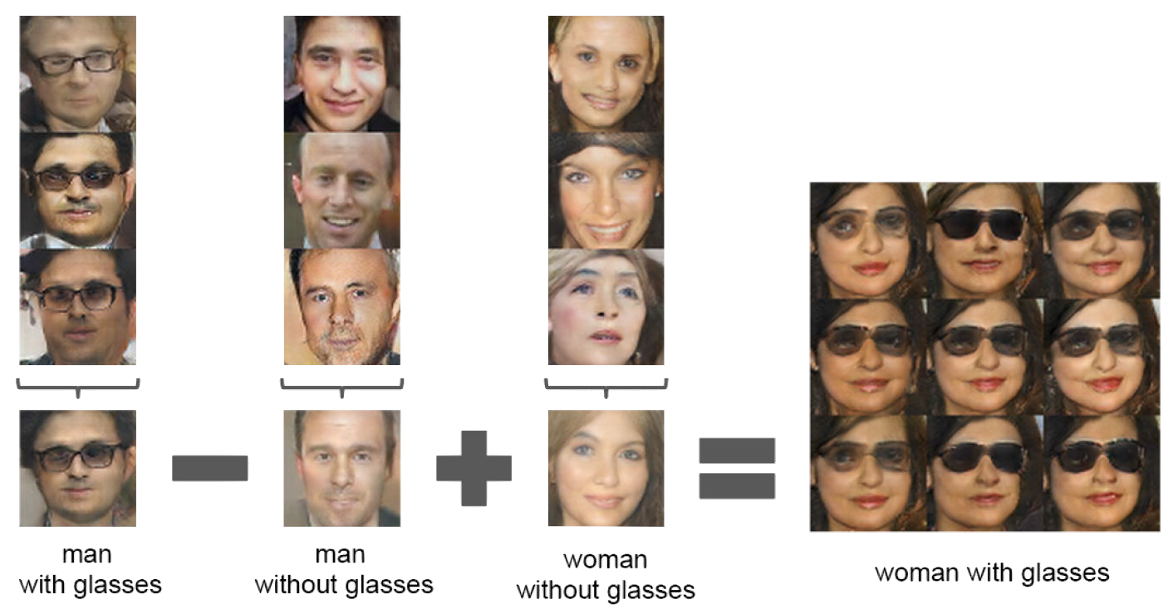
Latent vectors capture interesting patterns…
Radford, Alec, Luke Metz, and Soumith Chintala. "Unsupervised representation learning with deep convolutional generative adversarial networks." arXiv:1511.06434 (2015).

Slide 54
InfoGAN
We want to maximize the mutual information 𝐼
between 𝒄 and 𝐱
Incorporate in the value function of the minimax game.
Chen, X., Duan, Y., Houthooft, R., Schulman, J., Sutskever, I., & Abbeel, P. InfoGAN: Interpretable Representation Learning by Information Maximization Generative
Adversarial Nets, NIPS (2016).

Slide 55
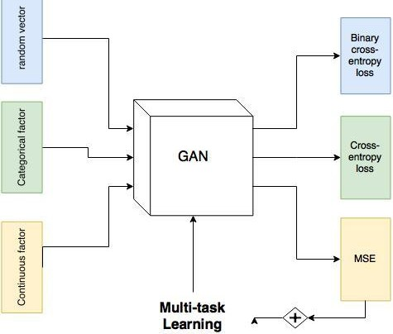
InfoGAN
Chen et al, InfoGAN : Interpretable Representation Learning by Information Maximizing Generative Adversarial Nets, 2016

Slide 56
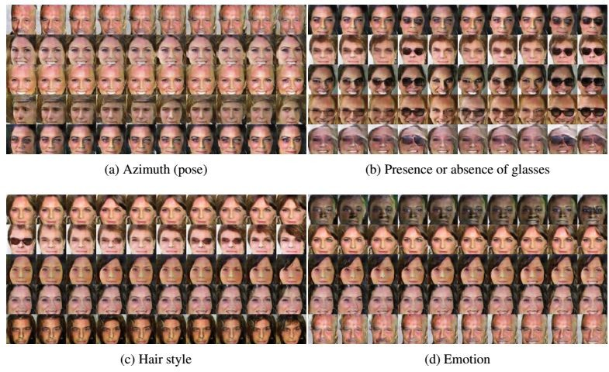
InfoGAN
Results
My implementation : https://github.com/buriburisuri/sugartensor/blob/master/sugartensor/example/mnist_info_gan.py

Slide 57
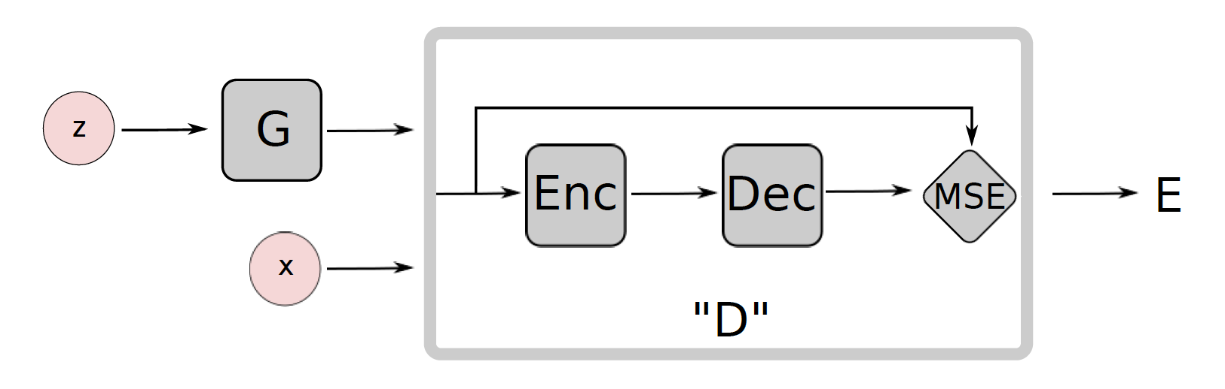
Energy-Based GANs
Modified game plans
Generator will try to generate samples with low values
Discriminator will try to assign high scores to fake values
𝐷 𝑥
= ||𝐷𝑒𝑐 𝐸𝑛𝑐 𝑥
− 𝑥||_{ijk}
Use AutoEncoder inside the Discriminator
Use Mean-Squared Reconstruction error as 𝑫 𝒙
High Reconstruction Error for Fake samples
Low Reconstruction Error for Real samples
Zhao, Junbo, Michael Mathieu, and Yann LeCun. "Energy-based generative adversarial network." arXiv preprint arXiv:1609.03126 (2016)

Slide 58
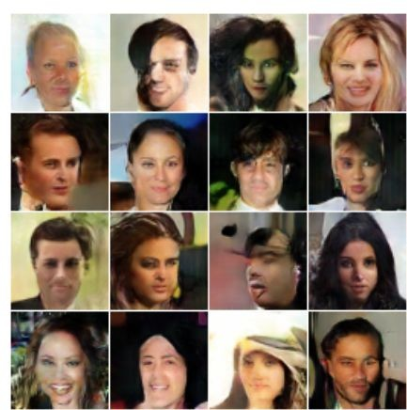
EBGAN
Results

Slide 59
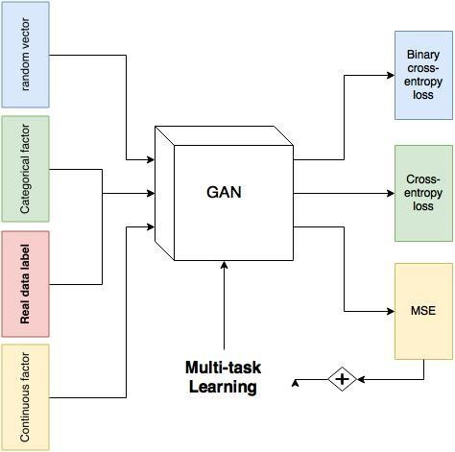
ACGAN
Ordena et al, Conditional Image Synthesis with Auxiliary Classifier GANs, 2016

Slide 60
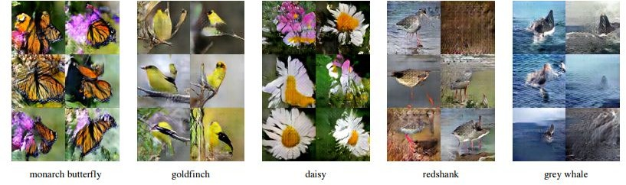
ACGAN
Results

Slide 61
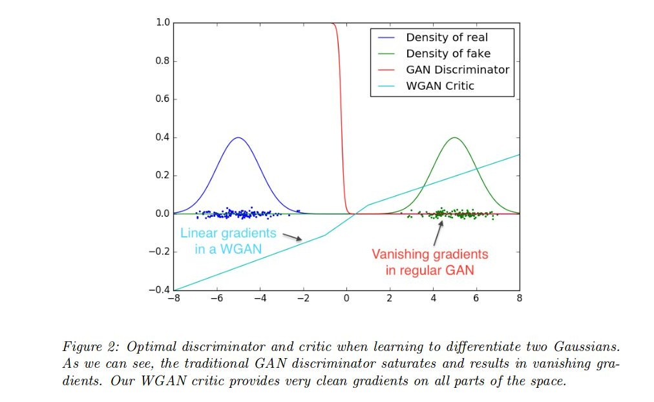
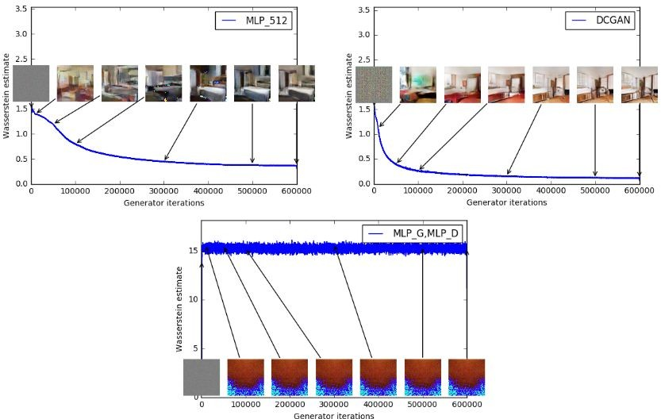
WGAN
Martin et al, Wasserstein GAN, 2017
Prevent the gradient vanishing by using weak distance metrics

Slide 62
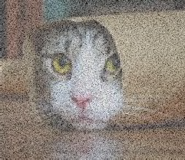
WGAN
High value Low value High value
real image
C
(critic)
G
(generator)
z :
Critic training Generator training
fake image

Slide 63
Part 3
Conditional GANs
Applications
Image-to-Image Translation
Text-to-Image Synthesis
Face Aging
Advanced GAN Extensions
Coupled GAN
LAPGAN – Laplacian Pyramid of Adversarial Networks
Adversarially Learned Inference
Summary

Slide 64
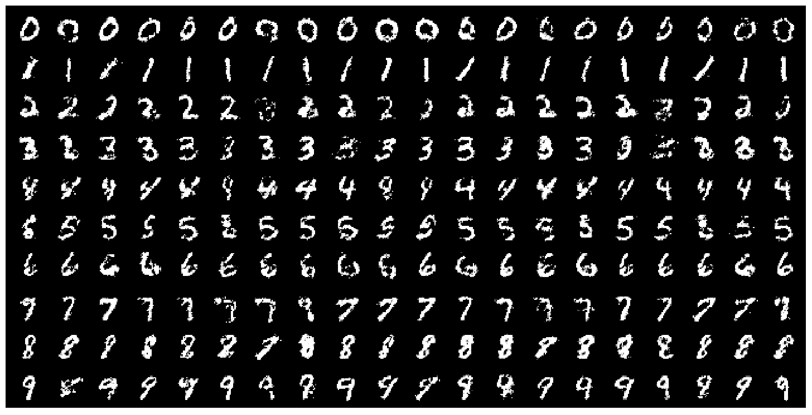
Conditional GANs
MNIST digits generated conditioned on their class label.
1, 0, 0, 0, 0, 0, 0, 0, 0, 0
0, 1, 0, 0, 0, 0, 0, 0, 0, 0
0, 0, 1, 0, 0, 0, 0, 0, 0, 0
0, 0, 0, 1, 0, 0, 0, 0, 0, 0
0, 0, 0, 0, 1, 0, 0, 0, 0, 0
0, 0, 0, 0, 0, 1, 0, 0, 0, 0
0, 0, 0, 0, 0, 0, 1, 0, 0, 0
0, 0, 0, 0, 0, 0, 0, 1, 0, 0
0, 0, 0, 0, 0, 0, 0, 0, 1, 0
0, 0, 0, 0, 0, 0, 0, 0, 0, 1
MN S i
Figure 2 in the original paper.
Mirza, Mehdi, and Simon Osindero. Conditional generative adversarial nets. arXiv preprint arXiv:1411.1784 (2014).

Slide 65
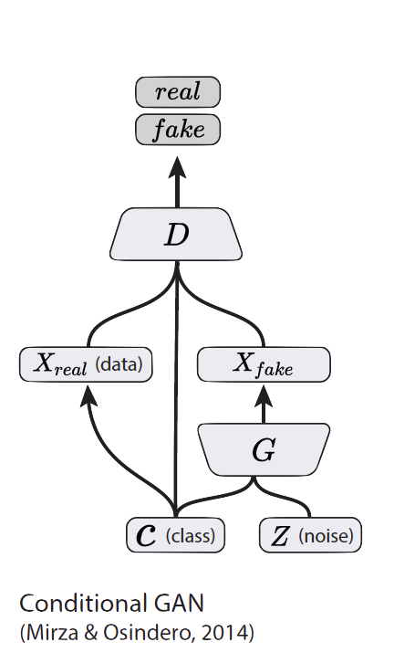
Conditional GANs
Simple modification to the original GAN framework that conditions the model on additional information for better multi-modal learning.
Lends to many practical applications of GANs when we have explicit supervision available.
Mirza, Mehdi, and Simon Osindero. “Conditional generative adversarial nets”. arXiv preprint arXiv:1411.1784 (2014).

Slide 66
Part 3
Conditional GANs
Applications
Image-to-Image Translation
Text-to-Image Synthesis
Face Aging
Advanced GAN Extensions
Coupled GAN
LAPGAN – Laplacian Pyramid of Adversarial Networks
Adversarially Learned Inference
Summary

Slide 67
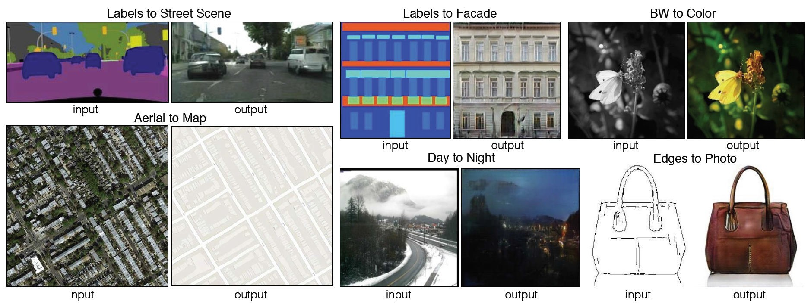
Image-to-Image Translation
Figure 1 in the original paper.
Link to an interactive demo of this paper
Isola, P., Zhu, J. Y., Zhou, T., & Efros, A. A. “Image-to-image translation with conditional adversarial networks”. arXiv preprint arXiv:1611.07004. (2016).

Slide 68
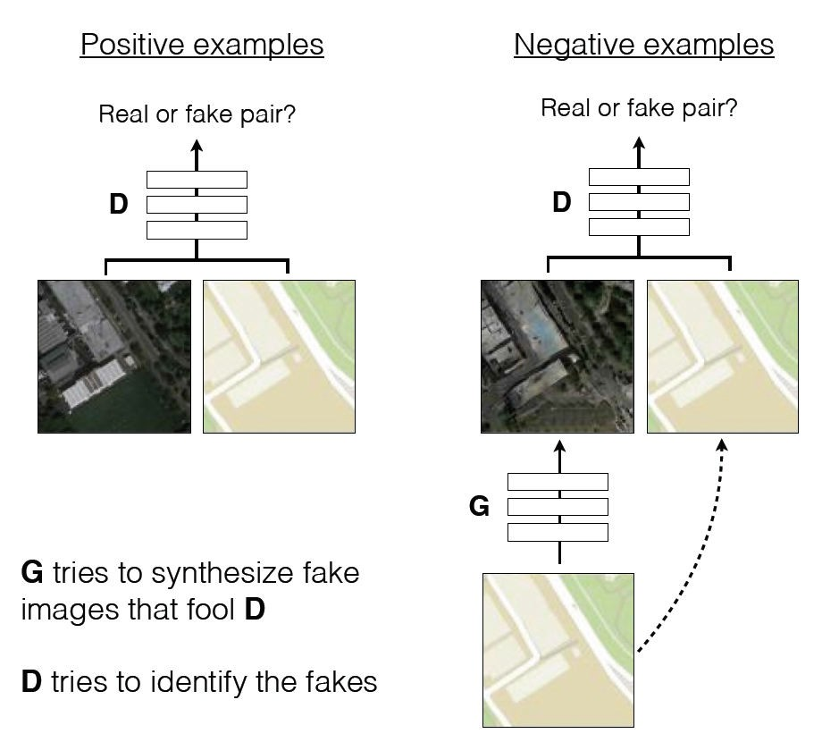
Image-to-Image Translation
Architecture: DCGAN-based architecture
Training is conditioned on the images from the source domain.
Conditional GANs provide an effective way to handle many complex domains without worrying about designing structured loss functions explicitly.
Figure 2 in the original paper.
Isola, P., Zhu, J. Y., Zhou, T., & Efros, A. A. “Image-to-image translation with conditional adversarial networks”. arXiv preprint arXiv:1611.07004. (2016).

Slide 69
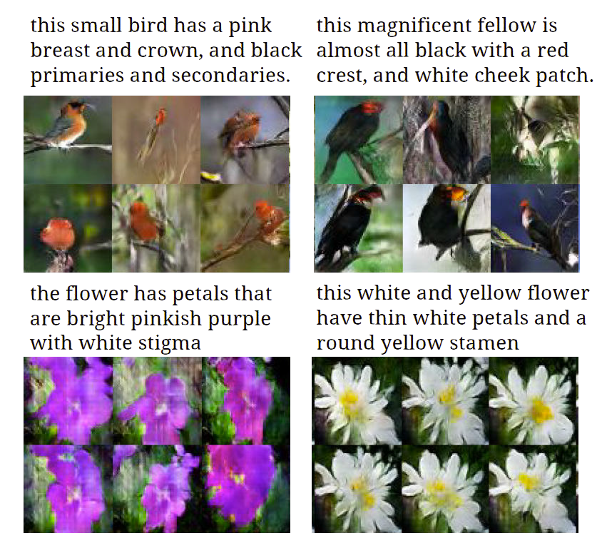
Text-to-Image Synthesis
Motivation
Given a text description, generate images closely associated.
Uses a conditional GAN with the generator and discriminator being condition on “dense” text embedding.
Figure 1 in the original paper.
Reed, S., Akata, Z., Yan, X., Logeswaran, L., Schiele, B., & Lee, H. “Generative adversarial text to image synthesis”. ICML (2016).

Slide 70
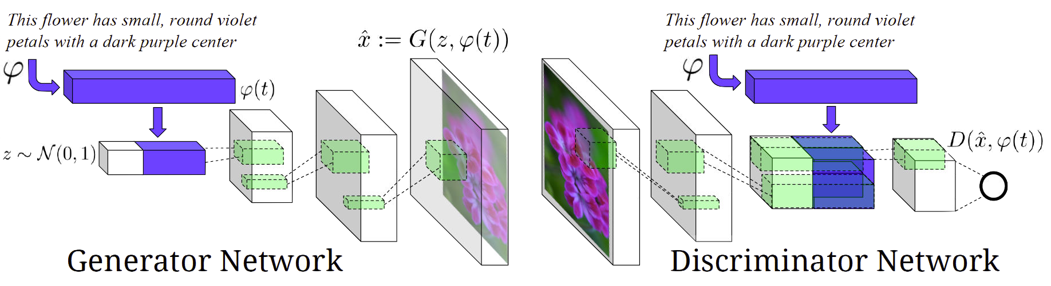
Text-to-Image Synthesis
Figure 2 in the original paper.
Positive Example: Real Image, Right Text
Negative Examples: Real Image, Wrong Text Fake Image, Right Text
Reed, S., Akata, Z., Yan, X., Logeswaran, L., Schiele, B., & Lee, H. “Generative adversarial text to image synthesis”. ICML (2016).

Slide 71
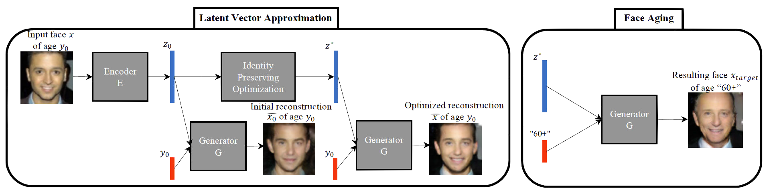
Face Aging with Conditional GANs
Differentiating Feature: Uses an Identity Preservation Optimization using an auxiliary network to get a better approximation of the latent code (z*) for an input image.
Latent code is then conditioned on a discrete (one-hot) embedding of age categories.
Figure 1 in the original paper.
Antipov, G., Baccouche, M., & Dugelay, J. L. (2017). “Face Aging With Conditional Generative Adversarial Networks”. arXiv preprint arXiv:1702.01983.

Slide 72
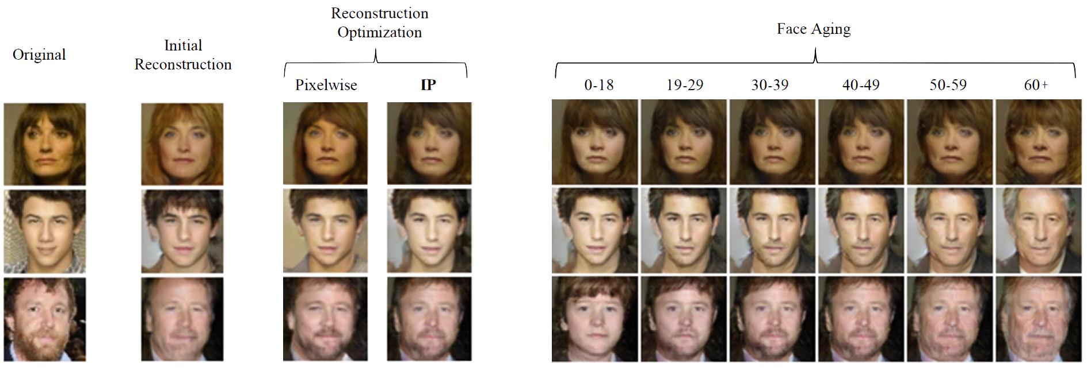
Face Aging with Conditional GANs
Figure 3 in the original paper.
Antipov, G., Baccouche, M., & Dugelay, J. L. (2017). “Face Aging With Conditional Generative Adversarial Networks”. arXiv preprint arXiv:1702.01983.

Slide 73
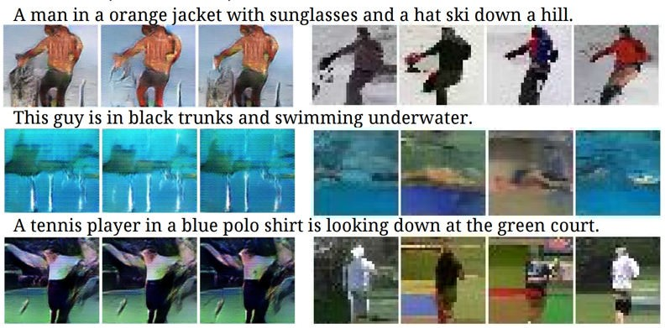
Conditional GANs
Conditional Model Collapse
Scenario observed when the Conditional GAN starts ignoring either the code (c) or the noise variables (z).
This limits the diversity of images generated.
Credit?
Mirza, Mehdi, and Simon Osindero. Conditional generative adversarial nets. arXiv preprint arXiv:1411.1784 (2014).

Slide 74
Part 3
Conditional GANs
Applications
Image-to-Image Translation
Text-to-Image Synthesis
Face Aging
Advanced GAN Extensions
Coupled GAN
LAPGAN – Laplacian Pyramid of Adversarial Networks
Adversarially Learned Inference
Summary

Slide 75
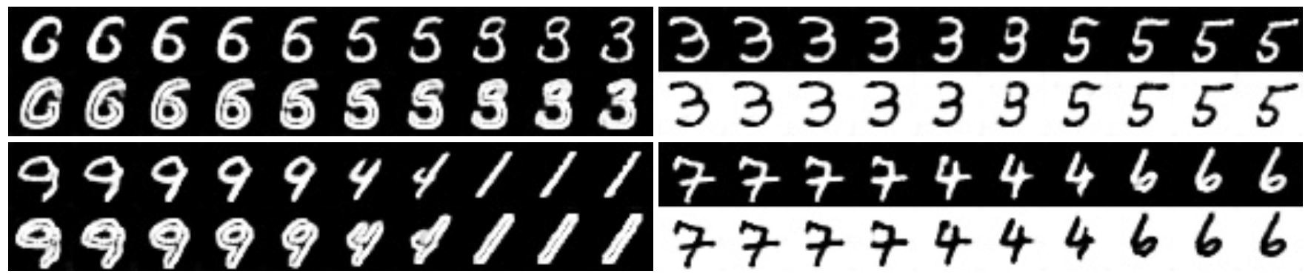
Coupled GAN
Figure 2 in the original paper.
Learning a joint distribution of multi-domain images.
Using GANs to learn the joint distribution with samples drawn from the marginal distributions.
Direct applications in domain adaptation and image translation.
Liu, Ming-Yu, and Oncel Tuzel. “Coupled generative adversarial networks”. NIPS (2016).

Slide 76
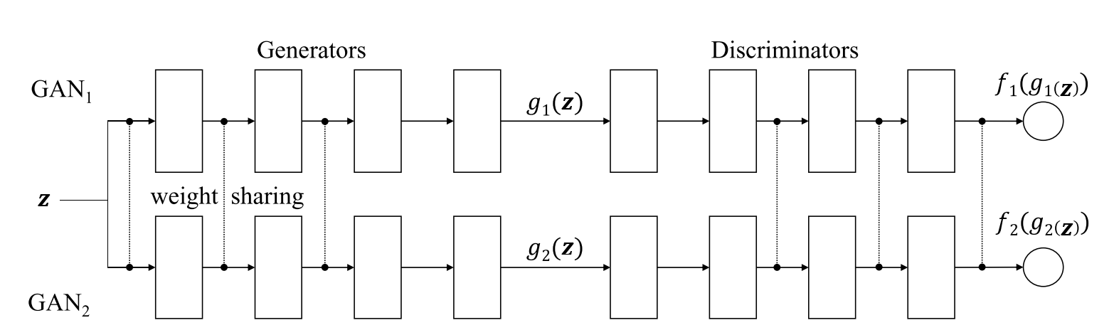
Coupled GANs
Architecture
Figure 1 of the original paper.
Weight-sharing constraints the network to learn a joint distribution without corresponding supervision.
Liu, Ming-Yu, and Oncel Tuzel. “Coupled generative adversarial networks”. NIPS (2016).

Slide 77
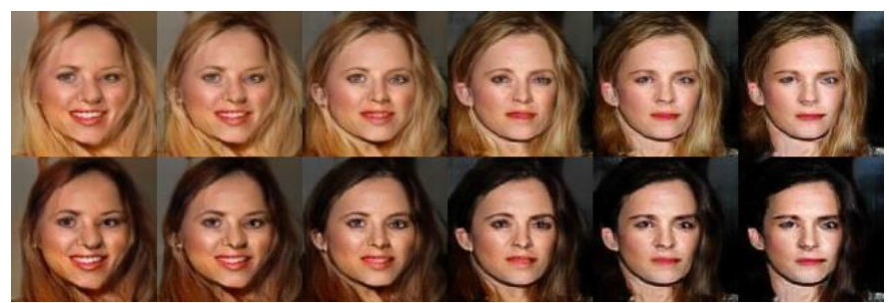
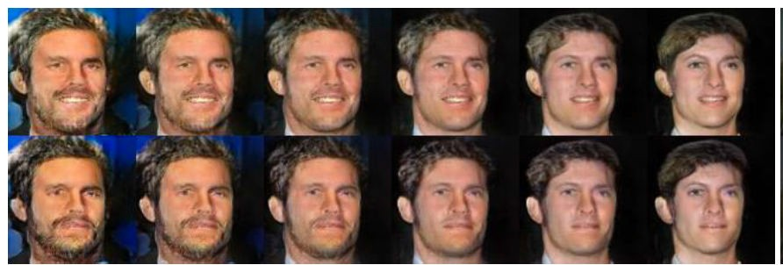
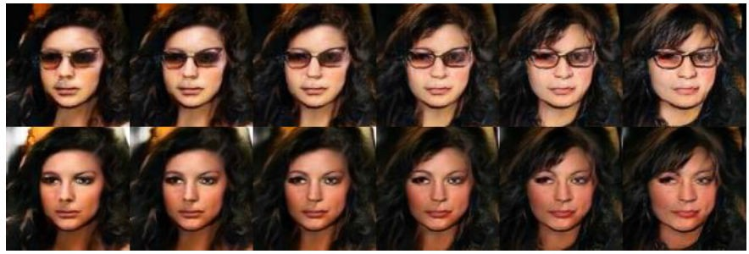
Coupled GANs
Hair Color
Some examples of generating facial images across different feature domains.
Corresponding images in a column are generate from the same latent code 𝑧
Facial Expression
Sunglasses
Figure 4 in the original paper.
Liu, Ming-Yu, and Oncel Tuzel. “Coupled generative adversarial networks”. NIPS (2016).

Slide 78
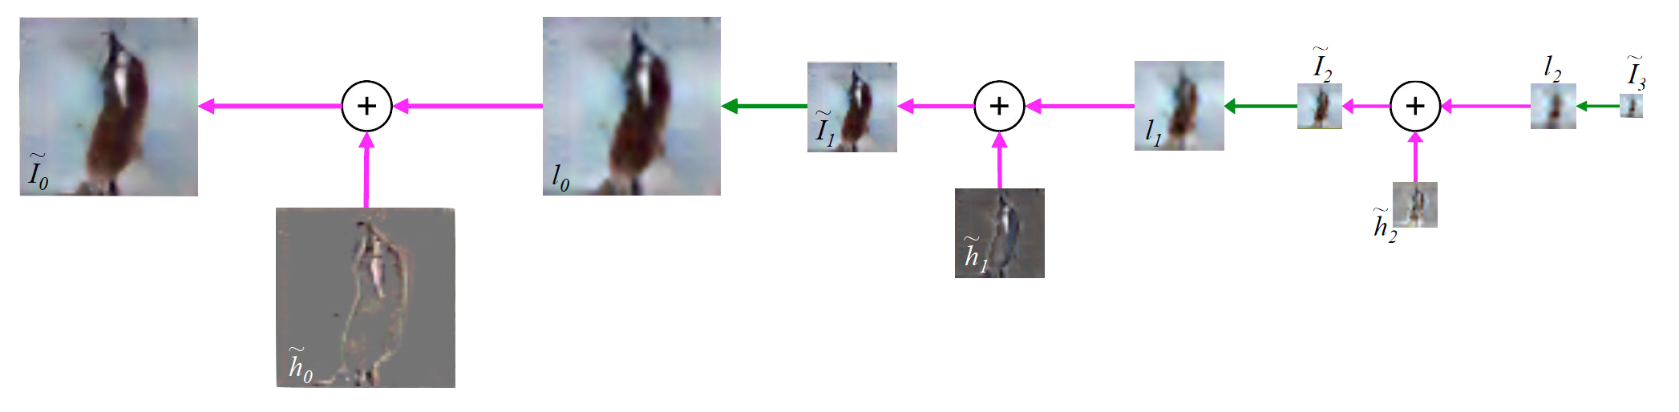
Laplacian Pyramid of Adversarial Networks
Figure 1 in the original paper. (Edited for simplicity)
Based on the Laplacian Pyramid representation of images. (1983)
Generate high resolution (dimension) images by using a hierarchical system of GANs
Iteratively increase image resolution and quality.
Denton, E.L., Chintala, S. and Fergus, R., 2015. “Deep Generative Image Models using a Laplacian Pyramid of Adversarial Networks”. NIPS (2015)

Slide 79
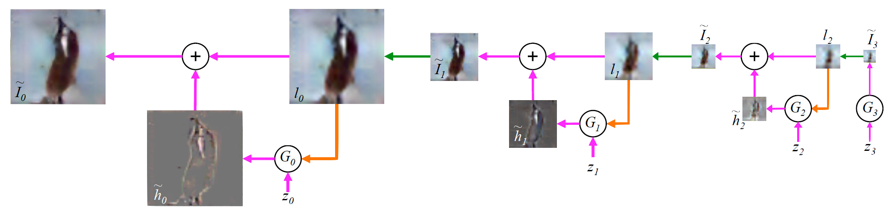
Laplacian Pyramid of Adversarial Networks
Figure 1 in the original paper.
Image Generation using a LAPGAN
Generator 𝐺 generates the base image 𝐼Ž from random noise input 𝑧.
Generators (𝐺_{J}, 𝐺_{I}, 𝐺) iteratively generate the difference image (ℎ‘ ) conditioned on previous small image (𝑙).
This difference image is added to an up-scaled version of previous smaller image.
Denton, E.L., Chintala, S. and Fergus, R., 2015. “Deep Generative Image Models using a Laplacian Pyramid of Adversarial Networks”. NIPS (2015)

Slide 80

Laplacian Pyramid of Adversarial Networks
Figure 2 in the original paper.
Training Procedure:
Models at each level are trained independently to learn the required representation.
Denton, E.L., Chintala, S. and Fergus, R., 2015. “Deep Generative Image Models using a Laplacian Pyramid of Adversarial Networks”. NIPS (2015)

Slide 81
Adversarially Learned Inference
Basic idea is to learn an encoder/inference network along with the generator network.
Consider the following joint distributions over 𝑥 (image) and 𝑧 (latent variables) :
𝑞 𝑥, 𝑧 = 𝑞 𝑥 𝑞(𝑧|𝑥)
𝑝 𝑥, 𝑧 = 𝑝 𝑧 𝑝(𝑥|𝑧)
encoder distribution
generator distribution
Dumoulin, Vincent, et al. “Adversarially learned inference”. arXiv preprint arXiv:1606.00704 (2016).

Slide 82

Adversarially Learned Inference
Discriminator Network
Encoder/Inference Network
Generator Network
Figure 1 in the original paper.
min max 𝔼_{< 1} [log 𝐷 𝑥, 𝐺;
$ '
𝑥 + 𝔼₃ ₁
log 1 − 𝐷 𝐺₁
𝑧 , 𝑧
Dumoulin, Vincent, et al. “Adversarially learned inference”. arXiv preprint arXiv:1606.00704 (2016).

Slide 83
Adversarially Learned Inference
Nash equilibrium yields
Joint:
Marginals:
Conditionals:
𝑝 𝑥, 𝑧
~ 𝑞 𝑥, 𝑧
𝑝 𝑥
~ 𝑞 𝑥 and 𝑝 𝑧 ~ 𝑞 𝑧
𝑝 𝑥|𝑧
~ 𝑞(𝑥|𝑧) and 𝑝 𝑧|𝑥
~ 𝑞 𝑧|𝑥
Inferred latent representation successfully reconstructed the original image.
Representation was useful in the downstream semi-supervised task.
Dumoulin, Vincent, et al. “Adversarially learned inference”. arXiv preprint arXiv:1606.00704 (2016).

Slide 84
Summary
GANs are generative models that are implemented using two stochastic neural network modules: Generator and Discriminator.
Generator tries to generate samples from random noise as input
Discriminator tries to distinguish the samples from Generator and samples from the real data distribution.
Both networks are trained adversarially (in tandem) to fool the other component. In this process, both models become better at their respective tasks.

Slide 85
Why use GANs for Generation?
Can be trained using back-propagation for Neural Network based Generator/Discriminator functions.
Sharper images can be generated.
Faster to sample from the model distribution: single forward pass generates a single sample.

Slide 86
Why study generative models?
•
Excellent test of our ability to use high-dimensional, complicated probability distributions
•
Simulate possible futures for planning or simulated RL
•
Missing data
•
Semi-supervised learning
•
Multi-modal outputs
•
Realistic generation tasks

Slide 87



For Next Video Frame Prediction
Ground Truth MSE Adversarial
(Lotter et al 2016)

Slide 88

Single Image Super-Resolution
(Ledig et al 2016)

Slide 89

iGAN
youtube (Zhu et al 2016)

Slide 90

Introspective Adversarial Networks
youtube
(Brock et al 2016)

Slide 91







Image to Image Translation
Input
Ground truth
Output
Labels to Street Scene
input
Aerial to Map
output
input
output
(Isola et al 2016)

Slide 92
Tips and tricks to improve GANs

Slide 93
Reducing GANs to RL
•
Generator makes a sample
•
Discriminator evaluates a sample
•
Generator's cost (negative reward) is a function of D(G(z))
•
Note that generator's cost does not include the data, x
•
Generator's cost is always monotonically decreasing in D(G(z))
•
Divergences change the location of the cost fastest decrease

Slide 94
Labels improve subjective sample quality
•
Learning a conditional model p(y|x) often gives much better samples from all classes than learning p(x) does (Denton et al 2015)
Even just learning p(x,y) makes samples from p(x) look much better to a human observer (Salimans et al 2016)
•
•
Note: this defines three categories of models (no labels, trained with labels, generating condition on labels) that should not be compared directly to each other

Slide 95
One-sided label smoothing
•
Default discriminator cost:
cross_entropy(1., discriminator(data))
+ cross_entropy(0., discriminator(samples))
One-sided label smoothed cost (Salimans et al 2016):
cross_entropy(.9, discriminator(data))
+ cross_entropy(0., discriminator(samples))
•

Slide 96
Do not smooth negative labels
cross_entropy(1.-alpha, discriminator(data))
+ cross_entropy(beta, discriminator(samples))
Reinforces current generator behavior
_{D(x) =} (1 − α)p_{data}(x) + βp_{model}(x)
p_{data}(x) + p_{model}(x)

Slide 97
Benefits of label smoothing
•
Good regularizer (Szegedy et al 2015)
•
Does not reduce classification accuracy, only confidence
•
Benefits specific to GANs:
•
Prevents discriminator from giving very large gradient signal to generator
•
Prevents extrapolating to encourage extreme samples

Slide 98
Batch Norm
•
Given inputs X={x⁽¹⁾, x⁽²⁾, .., x^{(m)}}
•
Compute mean and standard deviation of features of X
•
Normalize features (subtract mean, divide by standard deviation)
•
Normalization operation is part of the graph
•
Backpropagation computes the gradient through the normalization
•
This avoids wasting time repeatedly learning to undo the normalization

Slide 99


Batch norm in G can cause strong intra-batch correlation

Slide 100
Drawbacks of GANs

Slide 101






Problems with Counting

Slide 102







Problems with Perspective

Slide 103






Problems with Global Structure

Slide 104
GAN Evaluation
•
There is not any single compelling way to evaluate a generative model
•
Models with good likelihood can produce bad samples
•
Models with good samples can have bad likelihood
•
There is not a good way to quantify how good samples are
•
For GANs, it is also hard to even estimate the likelihood
•
See “A note on the evaluation of generative models,” Theis et al 2015, for a good overview

Slide 105
Hands On: Jupyter Notebook

Slide 106
Application of GANs

Slide 107

Generating image
Application of GANs
Wang et al, Generative Image Modeling using Style and Structure Adversarial Networks, 2016

Slide 108

Generating image
Application of GANs
Wang et al : Results

Slide 109










Generating image
Application of GANs
Jamonglab, 128x96 face image generation, 2016.11

Slide 110







Generating image
Application of GANs
Two-step generation : Sketch → Color
Binomial random seed instead of gaussian

Slide 111

Generating image
Application of GANs
Zhang et al, StackGAN : Text to Photo-realistic Image Synthesis with Stacked GANs, 2016

Slide 112

Generating image
Application of GANs
Zhang et al : Results

Slide 113

Generating image
Application of GANs
Reed et al, Learning What and Where to Draw, 2016

Slide 114

Generating image
Application of GANs
Reed et al : Results

Slide 115

Generating image
Application of GANs
Nguyen et al, Plug & Play Generative Networks, 2016
– Complex langevin sampling via DAE

Slide 116

Generating image
Application of GANs
Arici et al, Associative Adversarial Networks, 2016
– p(z|x) =

Slide 117

Generating image
Application of GANs
Arici et al : Results

Slide 118

Translating image
Application of GANs
Perarnau et al, Invertible Conditional GANs for image editing, 2016

Slide 119

Translating image
Application of GANs
Perarnau et al : results

Slide 120

Translating image
Application of GANs
Isola et al, Image-to-image translation with convolutional adversarial networks, 2016

Slide 121

Translating image
Application of GANs
Isola et al : Results

Slide 122

Translating image
Application of GANs
Ledig et al, Photo-Realistic Single Image Super-Resolution Using a GAN, 2016

Slide 123

Translating image
Application of GANs
Ledig et al : Results

Slide 124

Translating image
Application of GANs
Sajjadi et al, EnhanceNet : Single Image Super-Resolution through Automated Texture Synthesis, 2016
– SRGAN + Gram metrics loss

Slide 125

Domain adaptation
Application of GANs
Taigman et al, Unsupervised cross-domain image generation, 2016

Slide 126

Domain adaptation
Application of GANs
Taigman et al, Unsupervised cross-domain image generation, 2016

Slide 127

Domain adaptation
Application of GANs
Bousmalis et al, Unsupervised Pixel-Level Domain Adaptation with Generative Adversarial Networks, 2016

Slide 128

Domain adaptation
Application of GANs
Bousmalis et al : Results

Slide 129

Domain adaptation
Application of GANs
Shrivastava et al, Learning from simulated and unsupervised images through adversarial training, 2016

Slide 130

Domain adaptation
Application of GANs
Shrivastava et al : Results

Slide 131

Domain adaptation
Application of GANs
Taeksoo Kim et al, Learning to Discover Cross-Domain Relations with Generative Adversarial Networks, 2017

Slide 132



Domain adaptation
Application of GANs
Extended Taigman’s idea
using smart bijective mapping

Slide 133


Unsupervised clustering
Application of GANs
Jamonglab : https://github.com/buriburisuri/timeseries_gan
– Using InfoGAN
Real
Fake

Slide 134



Unsupervised clustering
Application of GANs

Slide 135

Text generation
Application of GANs
Yu et al, SeqGAN : Sequence Generative Adversarial Nets with Policy Gradient, 2016

Slide 136

Text generation
Application of GANs
Maddison et al, The concrete distribution : A continous relaxation of discrete random variables, 2016
Kusner et al, GANs for sequences of discrete elements with the Gumbel-softmax distribution, 2016

Slide 137

Text generation
Application of GANs
Zhang et al, Generating text via Adversarial Training, 2016

Slide 138

Imitation learning ( IRL or Optimal control )
Application of GANs
Ho et al, Model-free imitation learning with policy optimization, 2016
Finn et al, A connection between generative adversarial networks, Inverse Reinforcement Learning, and Energy-based models, 2016

Slide 139
Future of GANs

Slide 140
Pre-trained unified features
Future of GANs
Unified features by unsupervised learning
Pre-trained and shipped on mobile chip as default
E
(pre-trained encoder)
1(Good) 0(Bad)
C
(classifier)
x
z

Slide 141


Personalization at scale
Future of GANs
Environment ( User ) simulator

Slide 142

Personalization at scale
Future of GANs
Intelligent agent using RL

Slide 143



Personalization at scale
Future of GANs
For example, cardiac simulator using GAN

Slide 144
Conclusion
Future of GANs
Unsupervised learning is next frontier in AI
– Same algos, multiple domains
Creativity and experience are no longer human temperament
Towards Artificial General Intelligence

